Slide 1
Analytic Marching: An Analytic Meshing Solution from Deep Implicit Surface Networks
Presented by William Ashbee

Slide 2
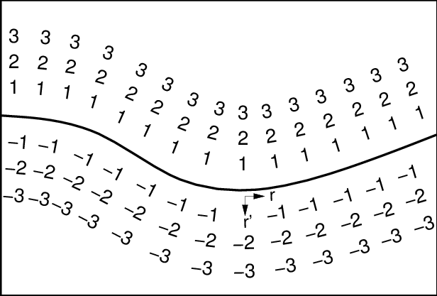
Introduction
This paper studies a geometric notion of object surface whose nature is a 2-dimensional manifold embedded in the 3D space
How do we recreate that surface: isosurface reconstruction?
Polygonal mesh – piecewise linear
Triangular mesh – 3 verticies per face
signed distance function
radial basis functions
Deep learning methods

Slide 3
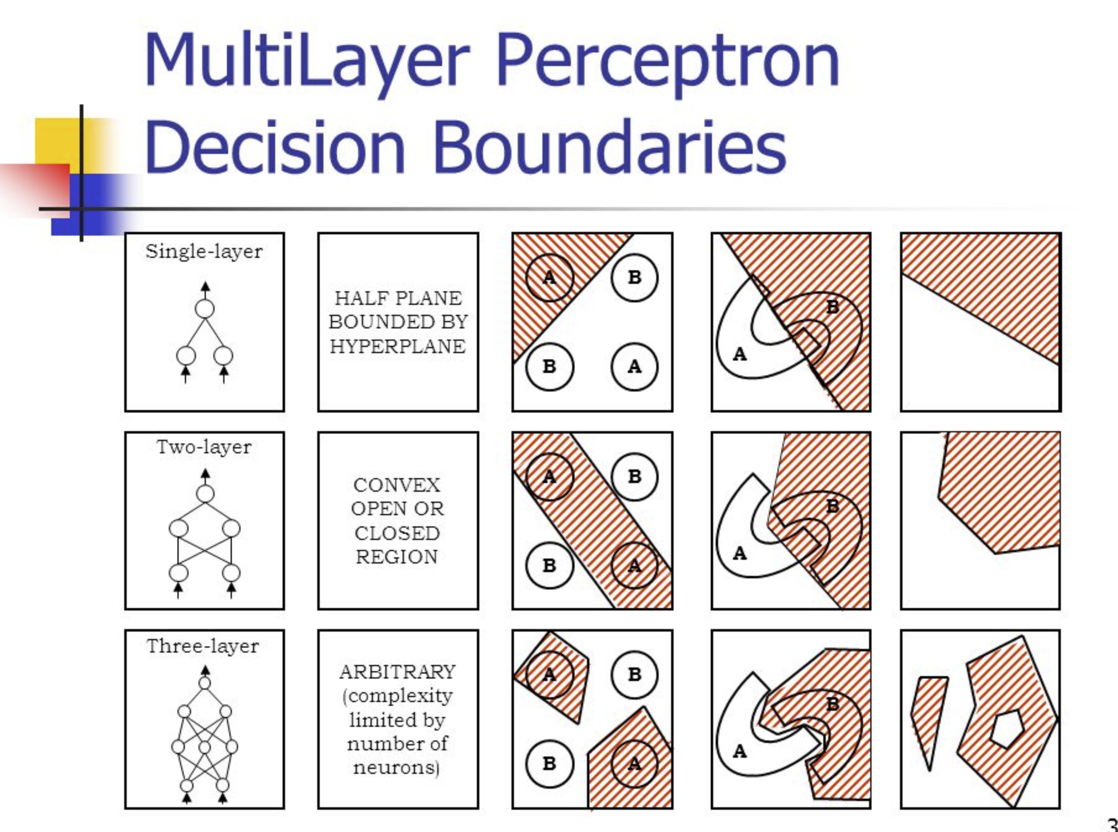
Introduction
MLP based on rectified linear units (ReLU) partitions its input space into a number of linear regions we identify from these regions analytic cells and analytic faces that are associated with zero level isosurface of the MLP based SDF.
Assuming that such a SDF learns its zero-level isosurface as a closed, piecewise planar surface, we characterize theoretical conditions under which analytic faces of the SDF connect and exactly form the surface mesh. Based on our theorem, we propose an algorithm of analytic marching, which marches among analytic cells to recover the exact mesh of the closed, piecewise planar surface captured by a learned MLP.

Slide 4
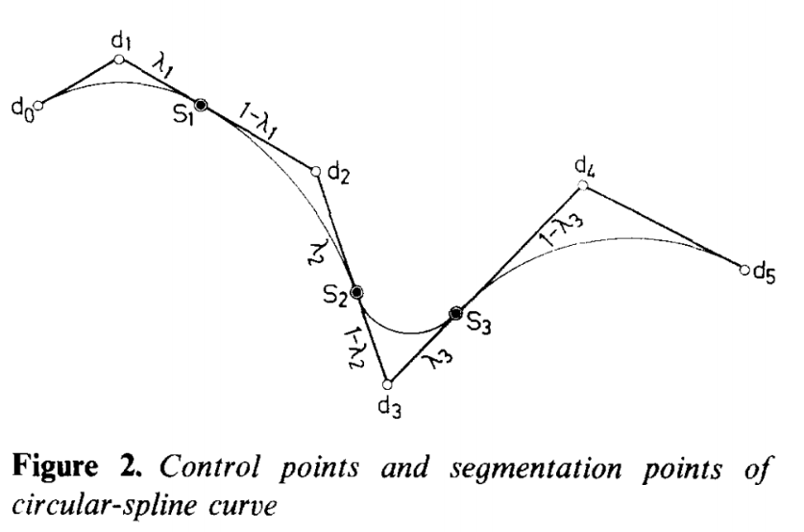
Related work (Implicit surface representation)
There are many ways to extract and specify iso-surfaces
Most use a series of points and associated equations to specify the surface in a piecewise fashion
Radial basis function (RBF) an alternative to the above algebraic functions. RBF-based approaches (Carr et al., 2001; 1997; Turk & OBrien, 1999) place the function centers near the surface and are able to reconstruct a surface from a discrete point cloud,
Where common choices of basis function include thin-plate spline
gaussian, multiquadric, and biharmonic/triharmonic splines

Slide 5
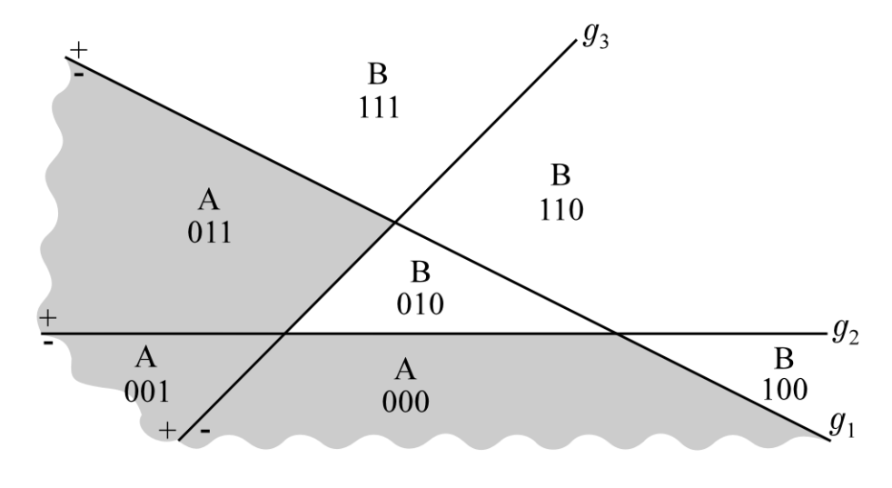
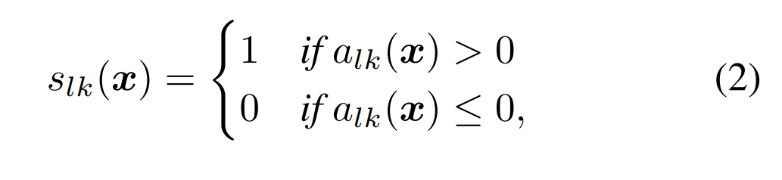
Analytic meshing via deep implicit surface networks
MLP’s create piecewise linear regions
The value of neural activations is either positive, negative or zero.
Only the nonzero activations are useful to recreating surface meshes

Slide 6
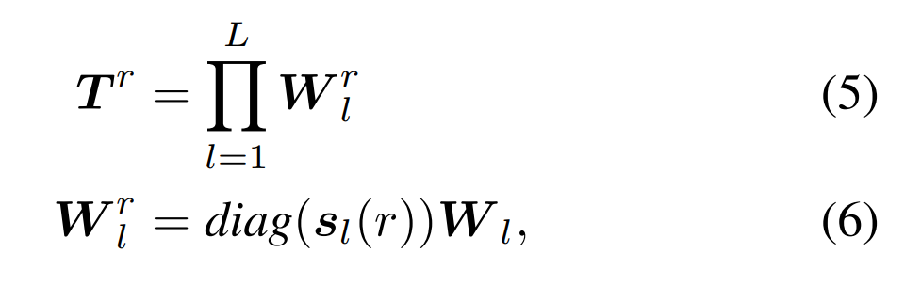
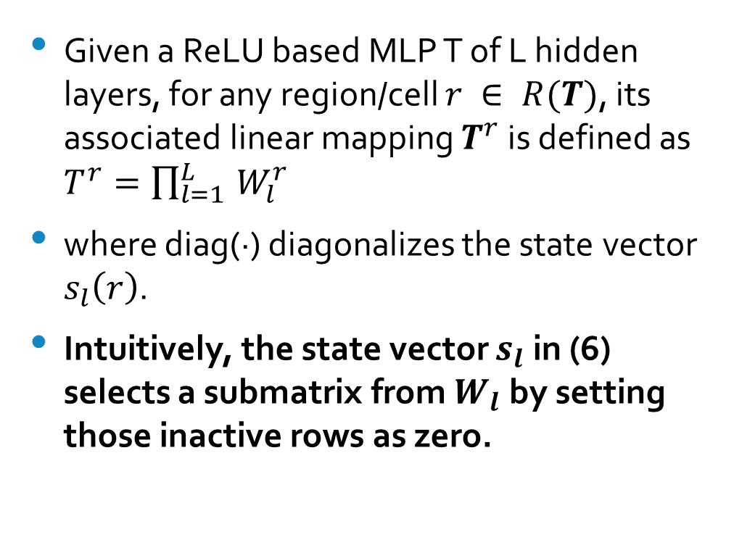
Analytic meshing via deep implicit surface networks (lemma 3)
Given a ReLU based MLP T of L hidden layers, for any region/cell $r ∈ R(T)$, its associated linear mapping $T^{r}$ is defined as $T^{r}=\prod_{l=1 }^{L}{W_{l}^{r}}$
where diag(·) diagonalizes the state vector $s_{l}\left(r\right)$.
Intuitively, the state vector $s_{l}$ in (6) selects a submatrix from $W_{l}$ by setting those inactive rows as zero.

Slide 7
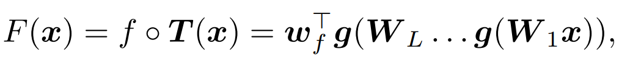
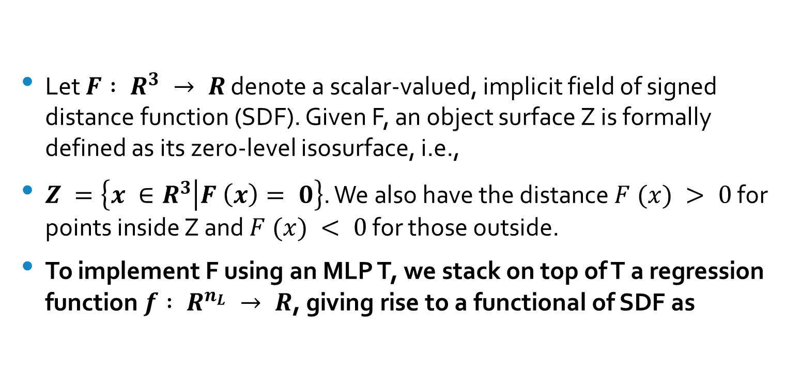
Analytic cells and faces associated with the zero level isosurface of an implicit field function
Let $F : R^{3} → R$ denote a scalar-valued, implicit field of signed distance function (SDF). Given F, an object surface Z is formally defined as its zero-level isosurface, i.e.,
$Z =\left\{x ∈R^{3} | F \left(x\right)= 0\right\}$. We also have the distance $F (x) > 0$ for points inside Z and $F (x) < 0$ for those outside.
To implement F using an MLP T, we stack on top of T a regression function $f : R^{n_{L}} → R$, giving rise to a functional of SDF as

Slide 8
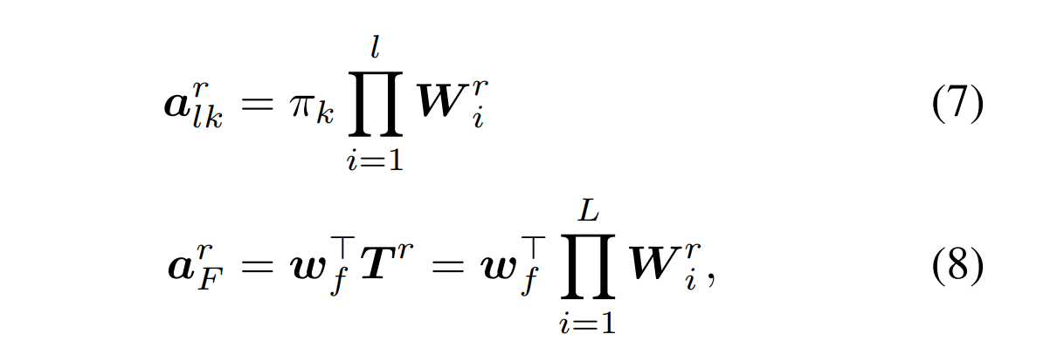
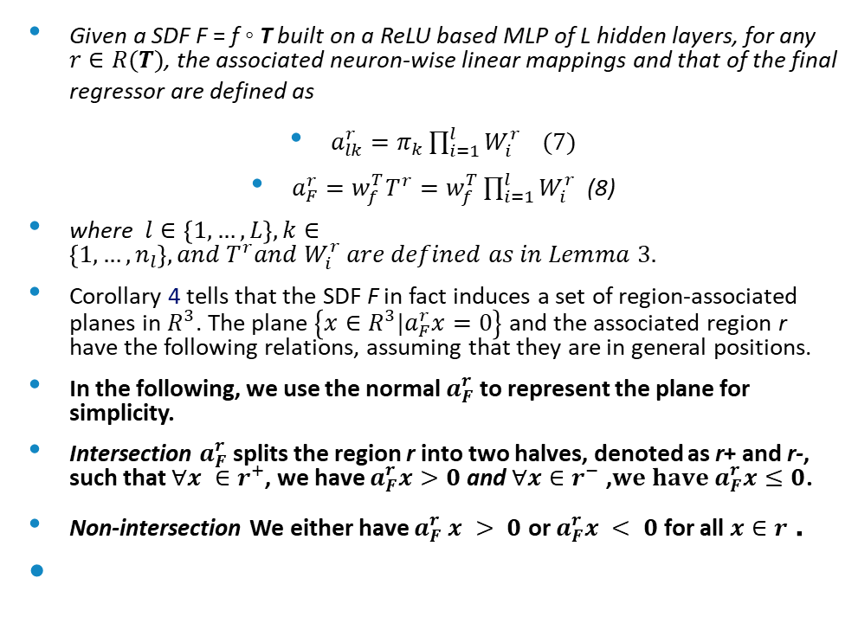
Corollary 4
Given a SDF F = f ◦ T built on a ReLU based MLP of L hidden layers, for any $r∈R(T)$, the associated neuron-wise linear mappings and that of the final regressor are defined as
$a_{lk}^{r}=π_{k}\prod_{i=1}^{l}{W_{i}^{r}} (7)$
$a_{F}^{r}=w_{f}^{T}T^{r}=w_{f}^{T}\prod_{i=1}^{l}{W_{i}^{r}}$ (8)
where $l∈\left\{1,…,L\right\}, k∈\left\{1,…, n_{l}\right\}, and T^{r}and W_{i}^{r} are defined as in Lemma 3.$
Corollary 4 tells that the SDF F in fact induces a set of region-associated planes in $R^{3}$. The plane $\left\{x∈R^{3}|a_{F}^{r}x=0\right\}$ and the associated region r have the following relations, assuming that they are in general positions.
In the following, we use the normal $a_{F}^{r}$to represent the plane for simplicity.
Intersection $a_{F}^{r}$splits the region r into two halves, denoted as r+ and r-, such that $∀x ∈r^{+}$, we have $a_{F}^{r}x>0$ and $∀x∈r^{−}$ ,$we have a_{F}^{r}x≤0$.
Non-intersection We either have $a_{F}^{r} x > 0$ or $a_{F}^{r}x < 0$ for all $x∈r$ .

Slide 9
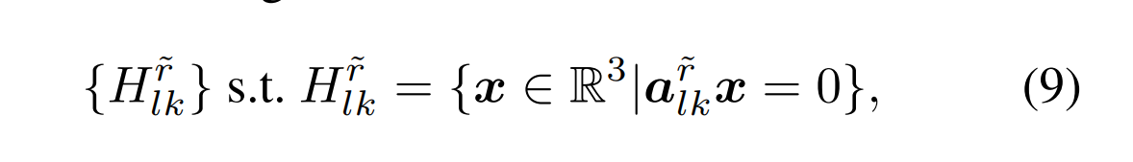
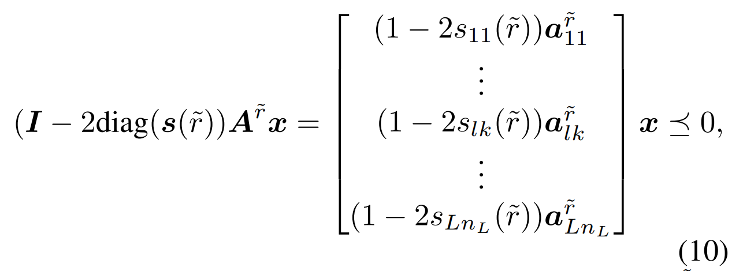
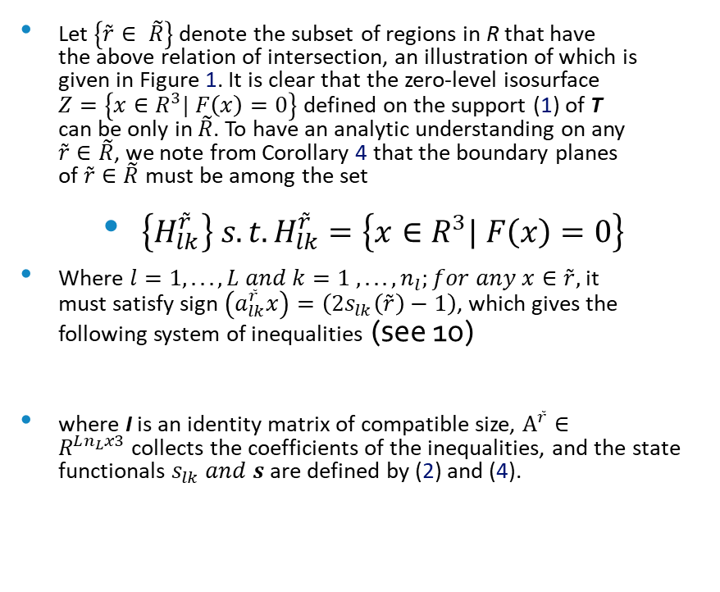
Corollary 4 continued
Let $\left\{\tilde{r}∈ \tilde{R}\right\}$ denote the subset of regions in R that have the above relation of intersection, an illustration of which is given in Figure 1. It is clear that the zero-level isosurface $Z=\left\{x∈R^{3}| F\left(x\right)=0\right\}$ defined on the support (1) of T can be only in $\tilde{R}$. To have an analytic understanding on any $\tilde{r}∈\tilde{R}$, we note from Corollary 4 that the boundary planes of $\tilde{r}∈\tilde{R}$must be among the set
$\left\{H_{lk}^{\tilde{r}}\right\} s.t.H_{lk}^{\tilde{r}}=\left\{x∈R^{3}| F\left(x\right)=0\right\}$
Where $l=1, . . . , L and k=1 , . . ., n_{l};for any x∈\tilde{r},$ it must satisfy sign $\left(a_{lk}^{\tilde{r}}x\right)=\left(2s_{lk}\left(\tilde{r}\right)−1\right)$, which gives the following system of inequalities (see 10)
where I is an identity matrix of compatible size, $A^{\tilde{r}}∈R^{Ln_{L}x3}$collects the coefficients of the inequalities, and the state functionals $s_{lk} and s$are defined by (2) and (4).

Slide 10
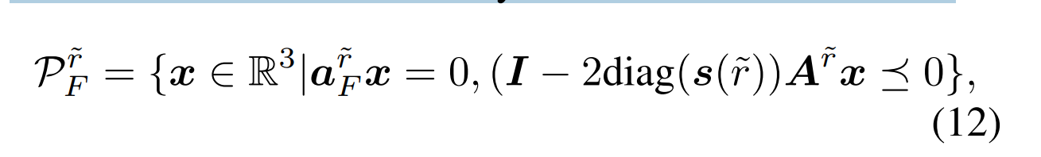
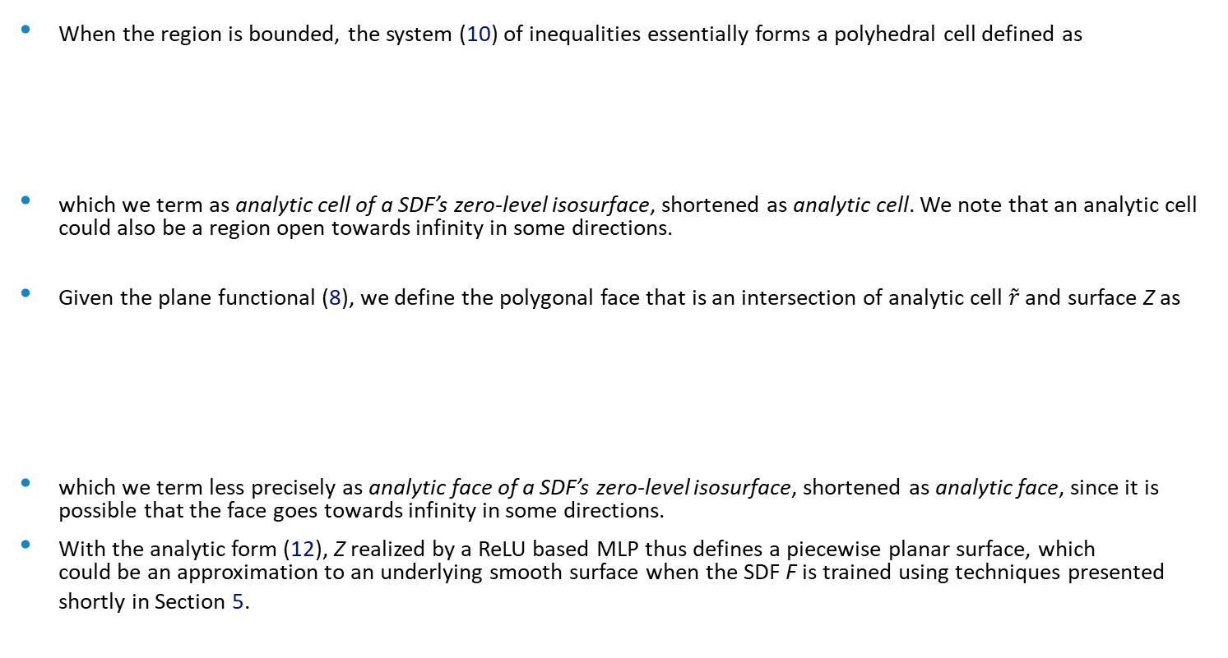
Corollary 4 continued 2
When the region is bounded, the system (10) of inequalities essentially forms a polyhedral cell defined as
which we term as analytic cell of a SDF’s zero-level isosurface, shortened as analytic cell. We note that an analytic cell could also be a region open towards infinity in some directions.
Given the plane functional (8), we define the polygonal face that is an intersection of analytic cell $\tilde{r}$ and surface Z as
which we term less precisely as analytic face of a SDF’s zero-level isosurface, shortened as analytic face, since it is possible that the face goes towards infinity in some directions.
With the analytic form (12), Z realized by a ReLU based MLP thus defines a piecewise planar surface, which could be an approximation to an underlying smooth surface when the SDF F is trained using techniques presented shortly in Section 5.

Slide 11
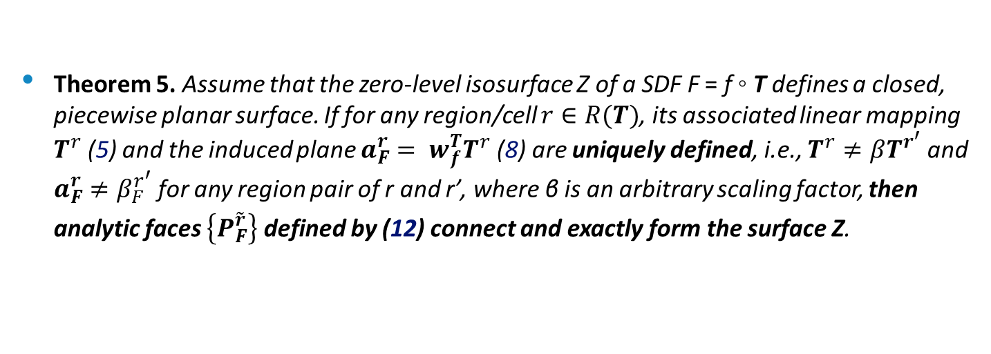
3.3. A closed mesh via connected cells and faces
Theorem 5. Assume that the zero-level isosurface Z of a SDF F = f ◦ T defines a closed, piecewise planar surface. If for any region/cell $r∈R(T)$, its associated linear mapping $T^{r}$ (5) and the induced plane $a_{F}^{r}= w_{f}^{T}T^{r}$ (8) are uniquely defined, i.e., $T^{r}≠βT^{r^{′}}$ and $a_{F}^{r}≠β_{F}^{r^{′}}$for any region pair of r and r’, where β is an arbitrary scaling factor, then analytic faces $\left\{P_{F}^{\tilde{r}}\right\}$ defined by (12) connect and exactly form the surface Z.

Slide 12
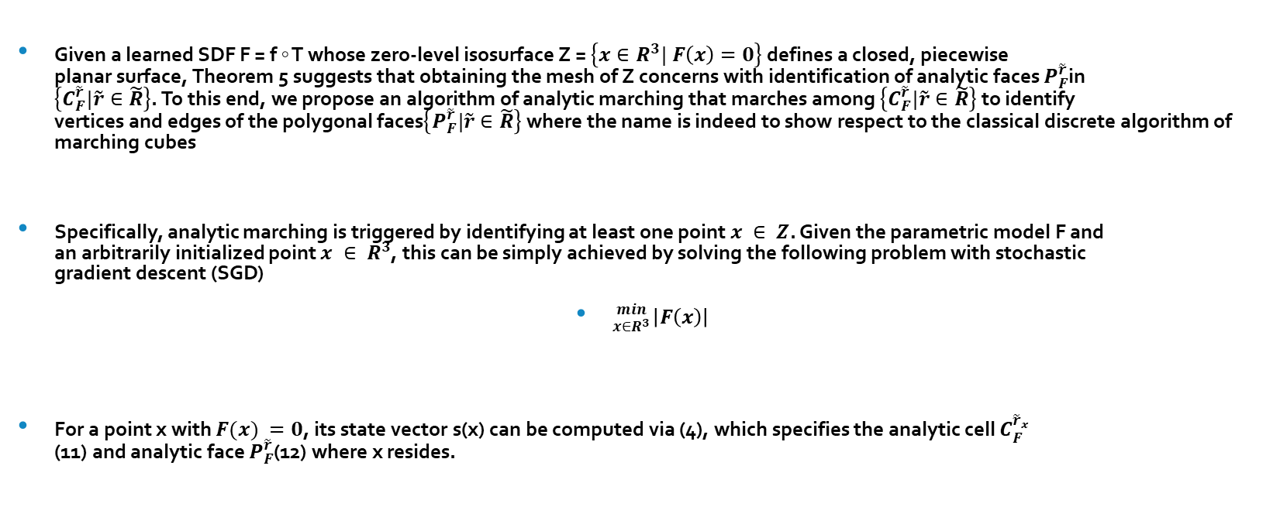
The proposed analytic marching algorithm
Given a learned SDF F = f ◦ T whose zero-level isosurface Z = $\left\{x∈R^{3}| F\left(x\right)=0\right\}$ defines a closed, piecewise planar surface, Theorem 5 suggests that obtaining the mesh of Z concerns with identification of analytic faces $P_{F}^{\tilde{r}}$in $\left\{C_{F}^{\tilde{r}}|\tilde{r}∈\tilde{R}\right\}$. To this end, we propose an algorithm of analytic marching that marches among $\left\{C_{F}^{\tilde{r}}|\tilde{r}∈\tilde{R}\right\}$ to identify vertices and edges of the polygonal faces$\left\{P_{F}^{\tilde{r}}|\tilde{r}∈\tilde{R}\right\}$ where the name is indeed to show respect to the classical discrete algorithm of marching cubes
Specifically, analytic marching is triggered by identifying at least one point $x ∈ Z$. Given the parametric model F and an arbitrarily initialized point $x ∈ R^{3}$, this can be simply achieved by solving the following problem with stochastic gradient descent (SGD)
${min \atop x∈R^{3}}\left|F\left(x\right)\right|$
For a point x with $F(x) =0$, its state vector s(x) can be computed via (4), which specifies the analytic cell $C_{F}^{{\tilde{r}}_{x}}$ (11) and analytic face $P_{F}^{\tilde{r}}$(12) where x resides.

Slide 13
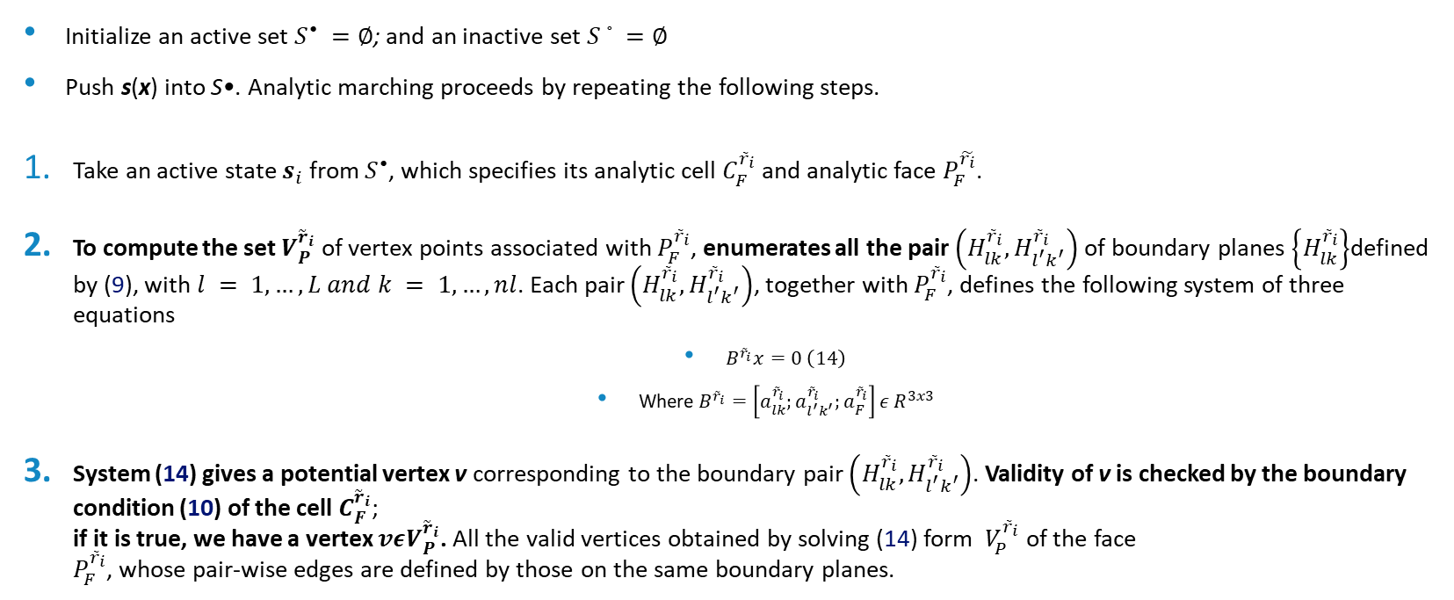
Analytic marching algorithm
Initialize an active set $S^{•} =∅$; and an inactive set $S^{◦}=∅$
Push s(x) into S•. Analytic marching proceeds by repeating the following steps.
Take an active state $s_{i}$ from $S^{•}$, which specifies its analytic cell $C_{F}^{{\tilde{r}}_{i}}$and analytic face $P_{F}^{\tilde{r_{i}}}$.
To compute the set $V_{P}^{{\tilde{r}}_{i}}$ of vertex points associated with $P_{F}^{{\tilde{r}}_{i}}$, enumerates all the pair $\left(H_{lk}^{{\tilde{r}}_{i}},H_{l^{′}k^{′}}^{{\tilde{r}}_{i}}\right)$ of boundary planes $\left\{H_{lk}^{{\tilde{r}}_{i}}\right\}$defined by (9), with $l = 1,…, L and k = 1, …, nl$. Each pair $\left(H_{lk}^{{\tilde{r}}_{i}},H_{l^{′}k^{′}}^{{\tilde{r}}_{i}}\right)$, together with $P_{F}^{{\tilde{r}}_{i}}$, defines the following system of three equations
$B^{{\tilde{r}}_{i}}x=0 \left(14\right)$
Where $B^{{\tilde{r}}_{i}}=\left[a_{lk}^{{\tilde{r}}_{i}};a_{l^{′}k^{′}}^{{\tilde{r}}_{i}};a_{F}^{{\tilde{r}}_{i}}\right]ε R^{3x3}$
System (14) gives a potential vertex v corresponding to the boundary pair $\left(H_{lk}^{{\tilde{r}}_{i}},H_{l^{′}k^{′}}^{{\tilde{r}}_{i}}\right)$. Validity of v is checked by the boundary condition (10) of the cell $C_{F}^{{\tilde{r}}_{i}}$; if it is true, we have a vertex $vεV_{P}^{{\tilde{r}}_{i}}$. All the valid vertices obtained by solving (14) form $V_{P}^{{\tilde{r}}_{i}}$ of the face $P_{F}^{{\tilde{r}}_{i}}$, whose pair-wise edges are defined by those on the same boundary planes.

Slide 14
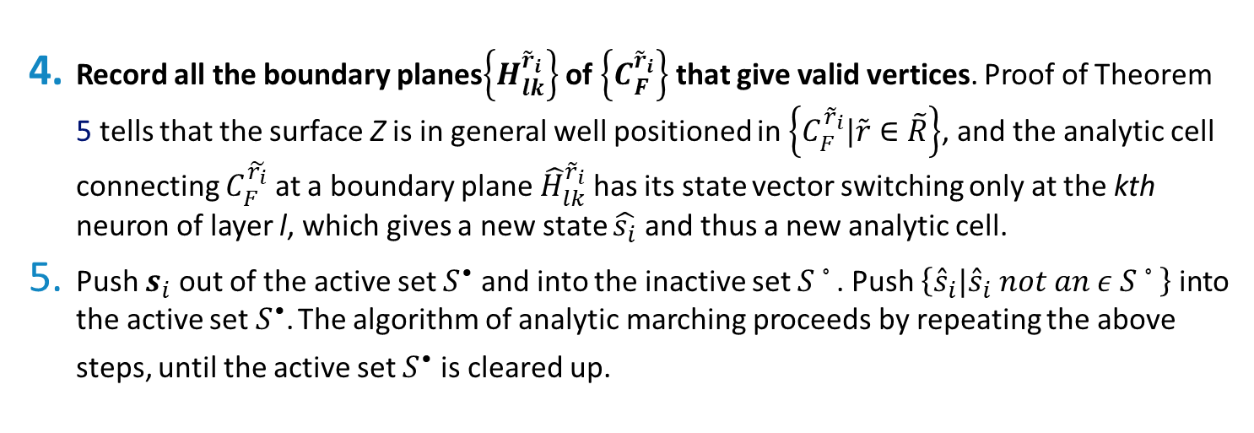
Analytic marching algorithm part III
Record all the boundary planes$\left\{H_{lk}^{{\tilde{r}}_{i}}\right\}$ of $\left\{C_{F}^{{\tilde{r}}_{i}}\right\}$ that give valid vertices. Proof of Theorem 5 tells that the surface Z is in general well positioned in $\left\{C_{F}^{{\tilde{r}}_{i}}|\tilde{r}∈\tilde{R}\right\}$, and the analytic cell connecting $C_{F}^{\tilde{r_{i}}}$ at a boundary plane ${\hat{H}}_{lk}^{{\tilde{r}}_{i}}$ has its state vector switching only at the kth neuron of layer l, which gives a new state $\hat{s_{i}}$ and thus a new analytic cell.
Push $s_{i}$ out of the active set $S^{•}$ and into the inactive set $S^{◦}$. Push $\left\{{\hat{s}}_{i}|{\hat{s}}_{i} not an ε S^{◦}\right\}$ into the active set $S^{•}$. The algorithm of analytic marching proceeds by repeating the above steps, until the active set $S^{•}$ is cleared up.

Slide 15
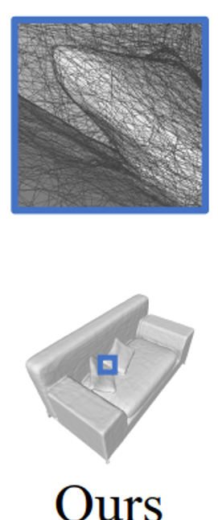
Algorithmic guarantee
Algorithmic guarantee Theorem 5 guarantees that when the SDF F learns its zero-level isosurface Z as a closed, piecewise planar surface, identification of all the analytic faces forms the closed surface mesh. The proposed analytic marching algorithm is anchored at the cell state transition of the above step 4, whose success is of high probability due to a phenomenon similar to the blessing of dimensionality. More specifically, it is of low probability that edges connecting planar faces of Z coincide with those of analytic cells

Slide 16
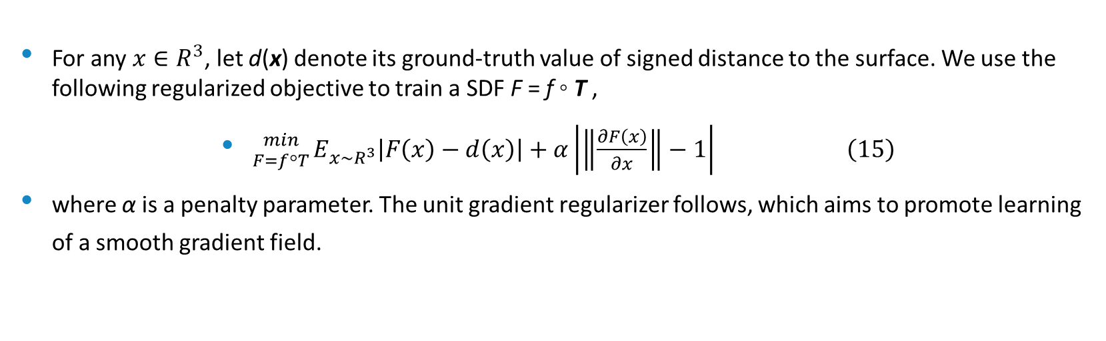
Training of deep implicit surface networks
For any $x∈R^{3}$, let d(x) denote its ground-truth value of signed distance to the surface. We use the following regularized objective to train a SDF F = f ◦ T ,
${min \atop F=f\text{◦}T}E_{x\sim R^{3}}\left|F\left(x\right)−d\left(x\right)\right|+α\left|\left\|\frac{∂F\left(x\right)}{∂x}\right\|−1\right| \left(15\right)$
where α is a penalty parameter. The unit gradient regularizer follows, which aims to promote learning of a smooth gradient field.

Slide 17
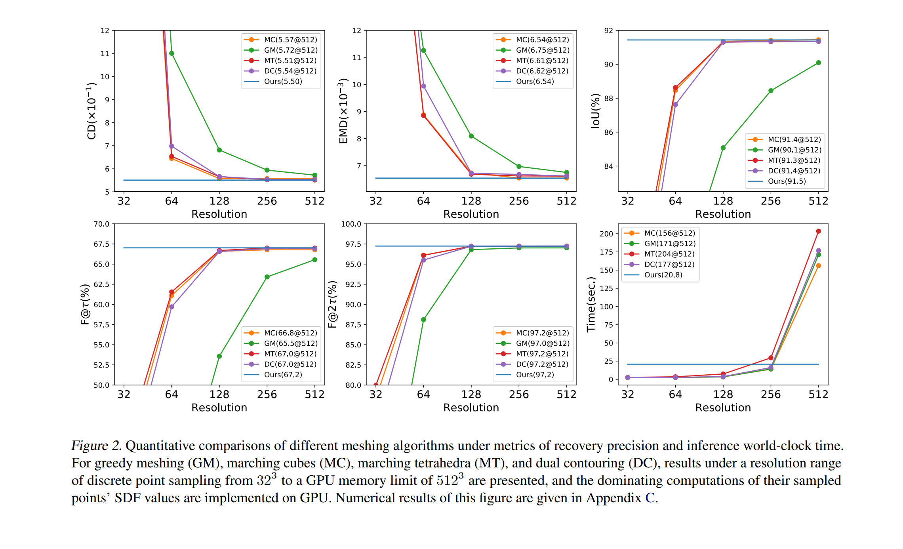
Quantitative comparison of various algorithms

Slide 18
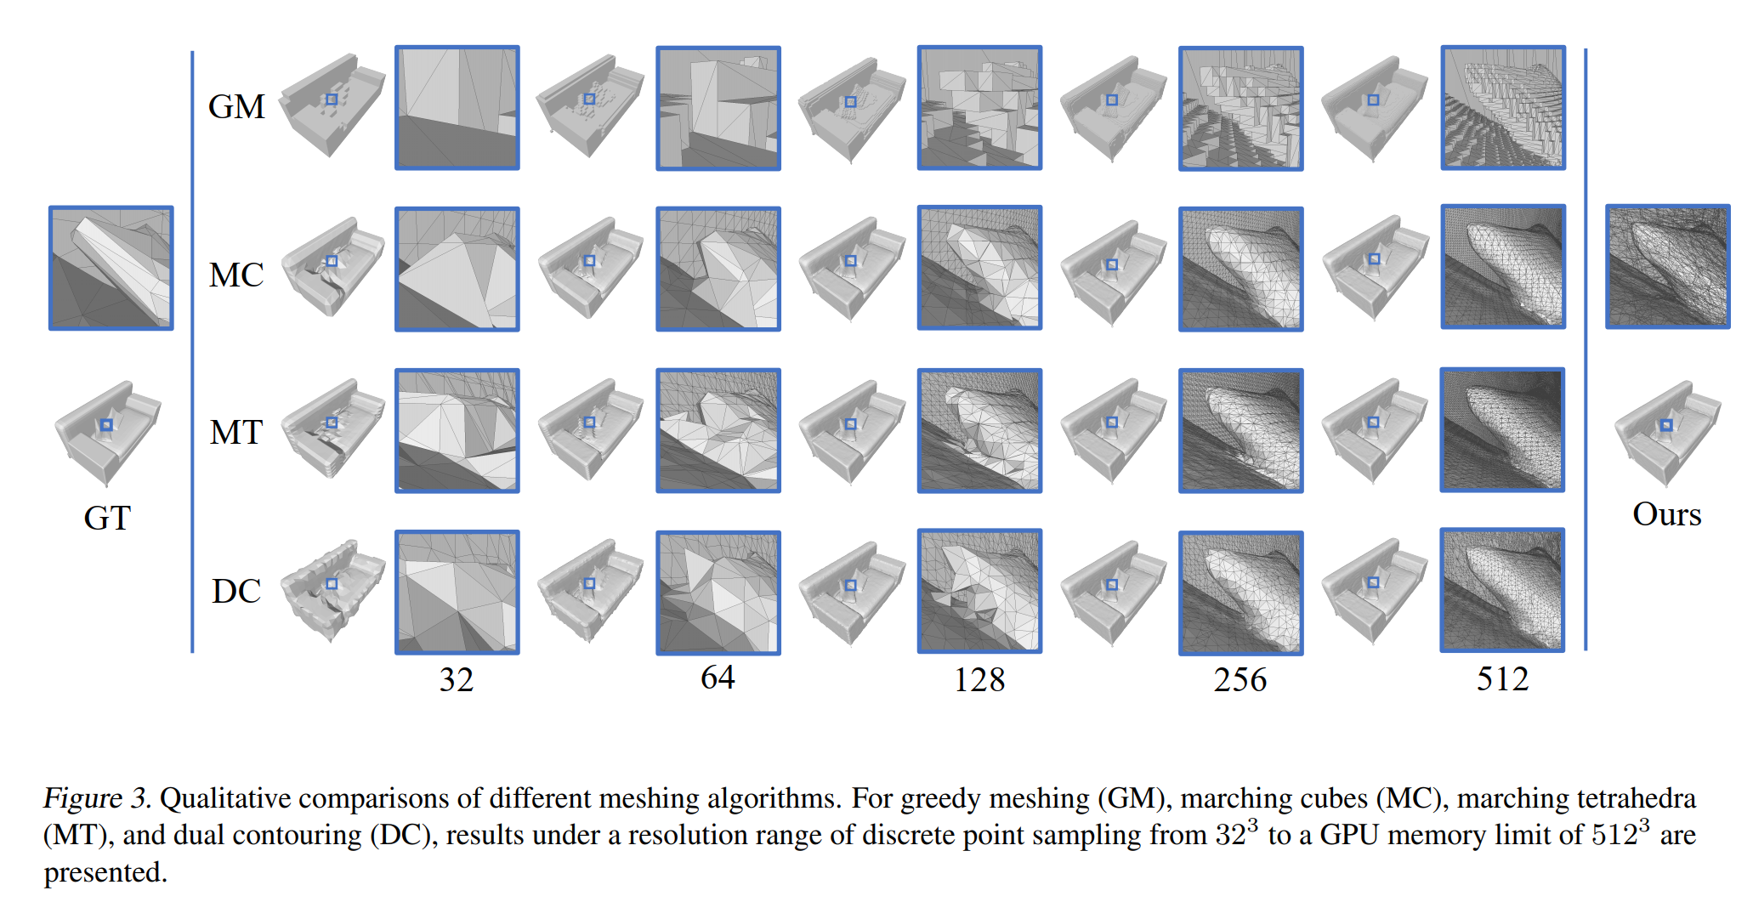
Qualitative comparison

